Slide 1
MLRC report on “Mastering Visual Continuous Control: Improved Data-Augmented Reinforcement Learning”
Debdeep Mukhopadhyay
Rahul Aditya
Supervisor: Prof. Aritra Hazra

Slide 2
Contents
Introduction
Scope Of Reproducibility
Methodology
Results - Ablation and Videos
Conclusion

Slide 3
Introduction
It has long been difficult to develop sample-efficient continuous control algorithms for reinforcement learning that can view high-dimensional images.
The RL community has made a tremendous effort on this topic, boosting sample efficiency dramatically.
However, they have proved to be inadequate for solving complex visual tasks such as those given in the DeepMind Control Suite.
Even the state-of-the-art algorithms turns out to be computationally heavy and hence need distributed GPU support.

Slide 4
Introduction: DrQ-v2
DrQ-v2 is a model-free reinforcement learning (RL) algorithm for visual continuous control.
DrQ-v2 provides significant improvements in sample efficiency across tasks from the DeepMind Control Suite.
Based on the idea of data augmentations to better capture pixels
Best model-free algorithm to have solved such hard visual control problems
DrQ-v2 is significantly better than DrQ, the previous version of the same algorithm.
Foundational changed from SAC to DDPG (Deep Deterministic Policy Gradient).
Uses the novel technique of bilinear interpolation of nearby pixels after data augmentation.
Adds noise randomly drawn from N(0, σ²) to let the agent explore in the starting episodes.

Slide 5
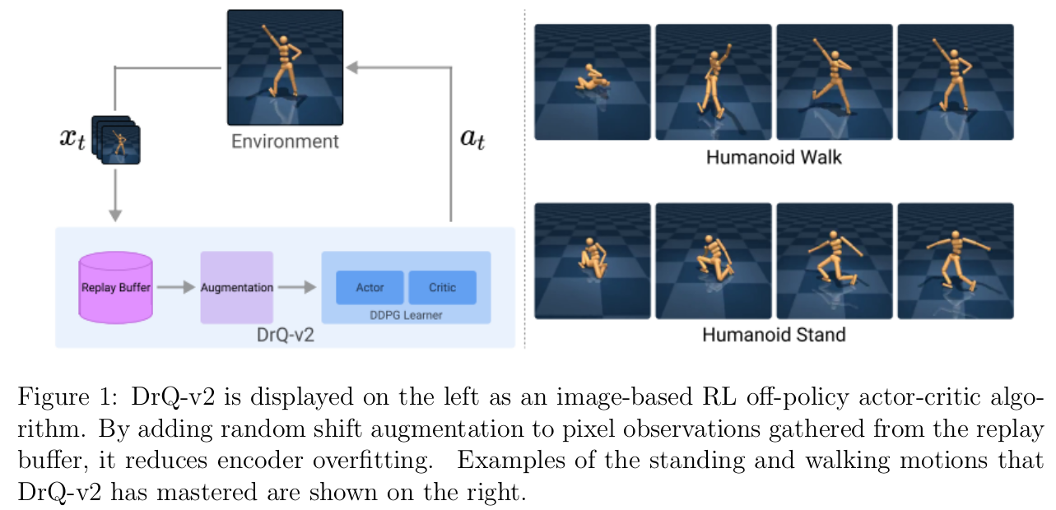
Introduction: DrQ-v2
Main features of DrQ-v2 that makes it better in performance and efficiency:
Size of the replay buffer has been increased 10 times with the belief that it will allow the agent to learn more about the environment at once.
The increased memory is adjusted with a smaller batch size of 256.
It does well against the standard algorithms in the domain that have the batch size set to 512.
The learning rate has been reduced to 0.0001 from 0.001 with the belief that the learning will be more stable.

Slide 6
Image Augmentation & Encoder
Image augmentation is done by applying random shifts.
Original image is first padded 4 pixels on each side of 84x84 pixels and a crop is then selected at random that gives an image with a +4 or -4 shift to the image.
Bilinear interpolation is done which is nothing but averaging the values of nearby pixels after data augmentation.
Convolutional encoder is used to embed the augmented picture observation into a low-dimensional latent vector.
The encoder used is the same as that used in SAC-AE.
This can be described by the function h = f (aug(x)).
aug(x) is the augmented image and f is the encoder.

Slide 7
Actor-Critic Algorithm
DDPG has been used as the foundational actor-critic RL algorithm.
TD error is then calculated using n-step returns.
This accelerates the spread of rewards and advances learning in general.
Finally, double Q-learning has been used to reduce overestimation bias.
Two functions to be learnt are Q_{θ1}and Q_{θ2}.
Transitions are sampled from the replay buffer D as τ = (x_{t}, at , r_{t:t+n-1} , x_{t+n} ).
Losses are computed as L_{θi} = E_{τ ∼ D} [Q_{θi} (x_{t} , a_{t} ) - y]², for i = 1, 2.
TD target y in the above equation is y = ∑_{i} γ^{i} r_{t+i} + γ^{n} min_{i=1,2} Q_{θi} (x_{t+n} , a_{t+n} )
h_{t} and h_{t+n} are the encoder outputs as times t and t+n.
a_{t}+n = π_{ϕ} (h_{t+n} ) + ϵ is the action as dictated by the policy with some additional noise.
ϵ is sampled from Normal distribution as ϵ ∼ N (0, σ²).
Lastly, the actor is trained by the function: L_{ϕ}(D) = -E_{xt ∼ D}[min_{i=1, 2} Q_{θi} (x_{t} , a_{t} )].

Slide 8
Results
We were able to reproduce most of the results by the authors. We executed our codes on Param-Shakti which is based on V100 GPU.
The entire DeepMind Control Suite was divided into easy, medium, and hard tasks. Each Easy task took 3.5 hours whereas each medium one took around 10 hours.
We were not able to reproduce the hard tasks because of restricted computational resources. Each hard tasks take around 86 hours of training according to the authors.
As part of the Ablation Study, we implemented our own version of SAC as it was not part of the code.
The experiment results that we reproduced against what has been claimed by the authors have been given in the next slide for easy and medium tasks in the DeepMind Control Suite.
Link to the complete results: Link

Slide 9
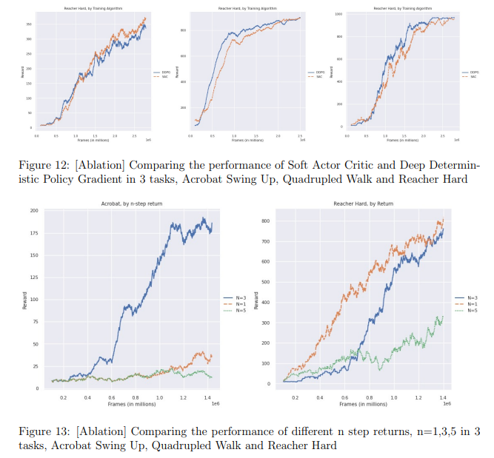
Results - Ablation Study
As part of the Ablation Study, we implemented our own version of SAC (Soft Actor Critic).
We studied the variation in the quality of the model when we varied n-step returns from 3 to 1 and 5.
We also replaced the decaying exploration rate by a fixed learning rate.
The figures show the results of Ablation Study.
The results of the tasks have been reported in the report and not mentioned in the slides for brevity,

Slide 10
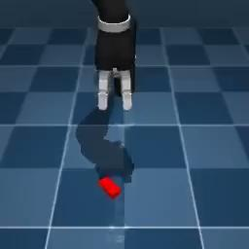
Results: Reach-Duplo game after training

Slide 11
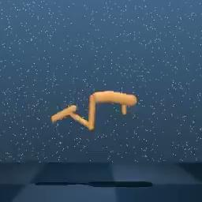
Results: Hopper-Hop game after training

Slide 12
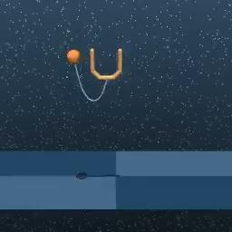
Results: Cup-catch game after training

Slide 13
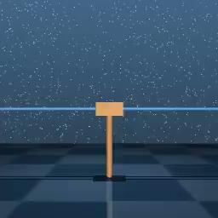
Results: Cartpole-Swingup game after training

Slide 14

Results: Finger Spin game after training

Slide 15
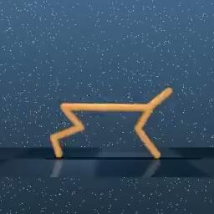
Results: Cheetah run game after training

Slide 16
Results
The experiment were conducted as follows:
9 easy and 12 medium Deep Mind Control Suit Tasks were trained on as told by the authors.
All tasks were completed in a similar frame of time as told by the authors and the results we obtained were extremely close to the author’s for most results.
Hard tasks that the authors trained for 86 hours were not done by us due to lack of compute.
All tasks were run on a V100 GPU, as also used by the authors, and it took 3.5 hours for the easy and about 10 hours each for the medium tasks
The main claims of the paper were hence successfully reproduced.

Slide 17
Ablation Studies
We perform 4 experiments to validate the author's’ choices:
DDPG (Deep Deterministic Policy Gradient) vs SAC (Soft Actor Critic): We write our own implementation of SAC to quantify the benefits of using DDPG over SAC.
We vary the n step returns that the agent uses for training from 3 to 1 and 5 to find the differences introduced by this
We use a buffer size of 100k time steps in place of the 1 Million Time steps to find the difference
The authors use a exploration schedule that linearly decays through the experiment, we replace it with a single constant exploration rate to find the difference
In all the experiments, we find the that the authors make the right choice. We also however note that the improvement from DDPG was overstated, given that they compared it to a vanilla SAC implementation, and our implementation brings closed results.

Slide 18
Conclusion
We reproduced the code of DrQ-v2 which is by far the best implementation in model-free algorithms of hard visual tasks. The results that we got for easy and medium tasks of the DeepMind Suite closely resemble those of the authors.
We developed our own implementation of the SAC algorithm to be able to do a more thorough analysis. We plan to implement further AC algorithms due to the encouraging results that we got.
We performed multiple ablation studies to gain a grasp of which hyper-parameters make the model work well. This also gave us further exploratory ideas that can be explored, in terms of both hyper-parameters and algorithmic changes.
We will use these leanings to further extend our analysis to these tasks in the future for the MLRC challenge.

Slide 19
Thank You

